Slide 1
Intergovernmental Fiscal Transfers for Health in India
Anit Mukherjee
8 May 2015

Slide 2
Motivation for the Study
Hypothesis: In a federal country, fiscal transfers for health need to be well-designed to achieve the objective of equity and improve outcomes
There has been a wide variety of experiments in fiscal arrangements in health – 12th FC Equalization Grants, 13th FC performance grants, NHRM/NHM, JSY, cash transfers through JSY
We reviewed the first three to draw lessons for the new fiscal architecture for health

Slide 3
CGD-AI Analysis: Review of 3 main channels of health transfers
Type of Transfer | Rationale | Approach | Funding
Centrally Sponsored Scheme – NHM | Provide additional resources to states to upgrade infrastructure and quality of service delivery | Set of High Focus states chosen. Centre provides 75% of funding (since 2012), states expected to put remaining 25% | Allocations vary annually. Rs. 18,875 crores given in 2015-16.
12th Finance commission- Equalisation Grants for Health | Improve average levels provisions of services and reduce inter-state disparity | Limited Equalisation based on a Needs Based Approach | Rs.5887.08 crore given to 7 states over 2005-2010
13th Finance Commission- Performance Incentive for Health | Incentivising States to reduce IMR | Performance incentive after 2 years based on movement in IMR | Rs.5000 crore over the remaining three years (2012 to 2015)

Slide 4
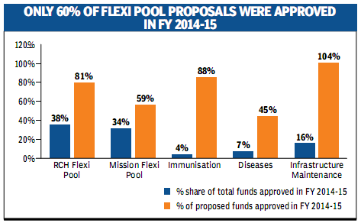
Findings: Review of NRHM
Limited Flexibility due to rigid Central Guidelines
Uniform norms across the country
Only 69% of total state proposals approved in 2014-15

Slide 5
States’ record of utilization of central
transfers is uneven
69% Utilisation of MoHFW (2007-2013)
FY2012-13
FY2013-14
Source: Budget Brief 2015-16, Accountability Initiative, New Delhi

Slide 6
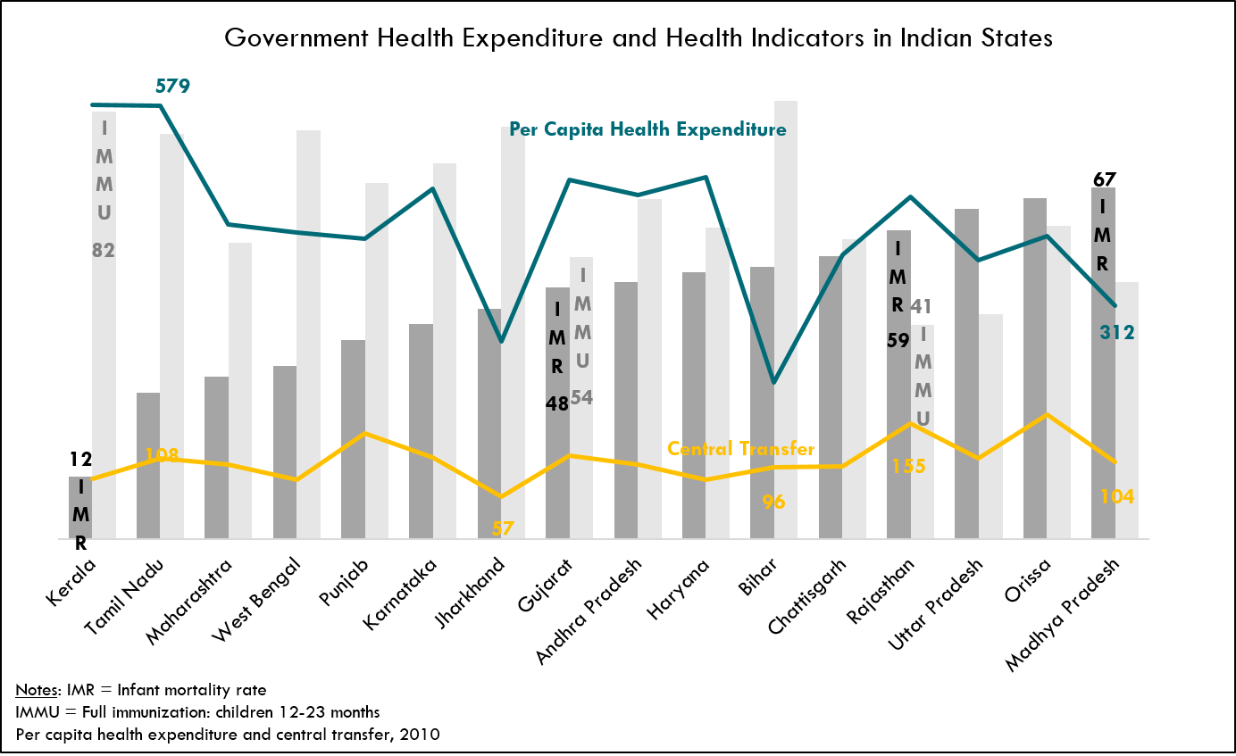
Inequalities in Health Financing and Outcome
Source: Sample Registration System of the Registrar General of India (2010); Choudhury, M. and Amarnath, H.K. (2012); Gupta, Choudhury and Patra (2014); MoHFW (2013). An Estimate of Public Expenditure on Health in India.

Slide 7
Findings: 12th FC Equalization Grants
The lack of a clear methodology regarding the adjustments to revenue expenditure makes it difficult to replicate the calculations
Many of the inter-governmental fiscal transfers come with conditionality
The impact of EGH on eliminating the horizontal imbalance among states was fairly limited
Finally, multiple sources of funds with their independent criteria and release mechanisms can at times lead to a fragmentation of transfers

Slide 8
Findings: 13th FC Performance-Based Grants for Health
The structure of the financing and payments in outcome-based fiscal transfers deserves careful attention
Assumption that states have upfront resources
Does level of reward commensurate “effort”
It is important to keep the outcome-based formula simple in designing fiscal transfer for indicators such as IMR which vary significantly across states
Lack of weight to population, birth rate or even trajectory of IMR decline
One alternative mechanism would be to provide incentive grants to states for ‘bending the curve’

Slide 9
65% of States Allocations go to <10% of the total population
Statewise distribution of Incentive Grants for Health from 13th FC, ‘12 – ‘13
Change in IMR
State Allocations of PGH
State Population as % of Total Population
0.2%
0.2%
0.1%
6.1%
0.3% of State Allocation goes to UP despite population size (16.8%)
2.3%
Source: Sample Registration System (2014); AI-CGD Calculations

Slide 10
14th Finance Commission Recommendations: Discussion Questions
Will states be willing to increase expenditure on health?
Are states able to increase expenditure on health?
Will they create new institutional structures for better health financing and delivery?
Will the Center have the ability to make necessary investments to reduce inter-regional disparities in health?
Will fiscal transfers be performance- and needs-based?
What would it take to enhance accountability of outcomes and generate better evidence of what works?

Slide 11
Preliminary analysis shows that state health expenditure will increase in some but not others
Health Expenditure as a % of Total Expenditure
2014-15 BE
2014-15 RE
2015-16 BE
Source: State Budgets

Slide 12
Questions? Comments? Suggestions?

Slide 13
APPENDIX

Slide 14
About the Center for Global Development
Independent, non-partisan think tank based in Washington, DC
Focus on global public goods and issues that can transform quality of life in LMIC
Promote policy alternatives
Research Areas
Global Health
Debt
Migration
Trade
Development Aid Effectiveness

Slide 15
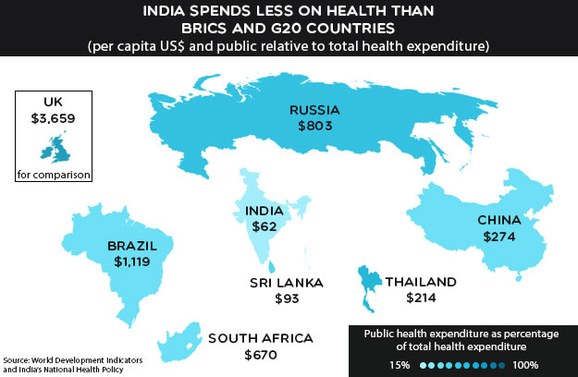
India spends less on health than BRICS and G20 countries

Slide 16
In many L/MICs, majority of government health spending is executed by sub-national entities
Source: Glassman and Sakuma (2014) – for details, see notes.
Notes:
Sources by Country
South Africa: IMF Government Finance Statistics (2011)
Indonesia: World Bank (2008). Investing in Indonesia’s Health: Challenges and Opportunities for Future Public Spending – Health Public Expenditure Review 2008. Washington DC, World Bank
India: IMF Government Finance Statistics (2011)
Ethiopia: Garcia, M. and A. S. Rajkumar (2008). Achieving Better Service Delivery Through Decentralization in Ethiopia. World Bank Working Papers. Washington DC, World Bank
Nigeria: Olaniyan, O. and A.O. Lawanson (2010). Health Expenditure and Health Status in Northern and Southern Nigeria: A Comparative Analysis Using NHA Framework. Paper presented at the 2010 CSAE conference held at St. Catherine’s College, University of Oxford, Oxford, UK
Argentina: IMF Government Finance Statistics (2011)
Brazil: Langevin, M. (2012). Brazil’s Healthcare System: Towards Reform? A BrazilWorks Briefing. Washington DC, BrazilWorks
Bolivia: IMF Government Finance Statistics (2011)

Slide 17
More recent data in India shows that 70% of public health spend is sub-national
CENTRE
67%
65%
STATE
Source: Ministry of Health and Family Welfare, 2015

Slide 18
Framework: “Better practices for IGFT design”
ALLOCATION
INCENTIVES
ACCOUNTABILITY
Better practices for allocating IGFT
Better practices for using incentives in IGFT
Better practices to account for IGFT
Simple
Predictable
Promotes equity
Promotes revenue adequacy
Fulfills grantor’s objectives
Promotes efficiency
Autonomous use of grants
Ensure financial and performance accountability
Promotes transparency
Notes:
It’s a difficult task to cleanly place different country experiences into categories
In any case, we’re oversimplifying, but this is what we’ve used as a way to understand the key issues
There are other ways to think about it – such as performance/effort/need
We’re not necessarily focused on ways to mobilize greater local contributions: put more emphasis on performance and need

Slide 19
Current Challenges
Low level of public and private expenditure on health (Mukherjee and Karmakar, 2009)
High sub-national inequality in public health expenditure and outcomes (Makela, Dandona et.al.,2013)
Fragmented healthcare delivery and low quality of care (Prinja, Bahuguna et.al.2013; Das and Hammer, 2014)
Increase in out-of-pocket expenditure and impact on poverty (Shahrawat and Rao, 2011; Garg and Karan, 2009; Banerjee, Deaton and Duflo, 2004)
Notes:
7 states with lowest health outcomes have a combined population of 550 million

Slide 20
Policy Window Opportunities
There is general consensus that time has come for structural reform of health system financing and delivery
Greater devolution of taxes from Centre to State governments from 2015 following Finance Commission recommendations
Restructuring of federal transfers for health requiring greater co-financing by states to leverage federal funds
New draft National Health Policy is still a work in progress
Health finance reform put on hold, new proposal later in 2015 required to address the same issues as Working Group

Slide 21
Nigeria: Improving Primary Health Care via the Basic Health Care Provision Fund
Implications Beyond India

Slide 22
14th Finance Commission
14th Finance Commission increased tax devolution to states from 32% to 42% ─ the biggest ever increase in India’s fiscal history
What is the Finance Commission?
Constitutional body, non-political comprised of technical experts
Determines the sharing of tax revenue between federal and state govts, and among states (vertical + horizontal devolution)
Recommendations binding on govt and implemented over 5-year period (e.g., 2015/16 to 2019/20)
Devolution Formula
Variable | Weights
 | 13th FC | 14th FC
Population (1971) | 25.0 | 17.5
Population (2011) | 0.0 | 10.0
Fiscal Capacity/Income Distance | 47.5 | 50.0
Area | 10.0 | 15.0
Forest Cover | 0.0 | 7.5
Fiscal Discipline | 17.5 | 0.0
Total | 100 | 100

Slide 23
Grants projected and received as a proportion of health expenditure (%)
State | Projected | Actual (2005-10) | % Released
Bihar | 37 | 38 | -2%
Assam | 44 | 33 | 25%
Jharkhand | 21 | 20 | 6%
Uttar Pradesh | 19 | 19 | -1%
Odisha | 7 | 7 | 1%
Madhya Pradesh | 5 | 4 | 11%
Uttarakhand | 5 | 4 | 11%
Source: AI-CGD calculations from Finance Accounts, various years

Slide 24
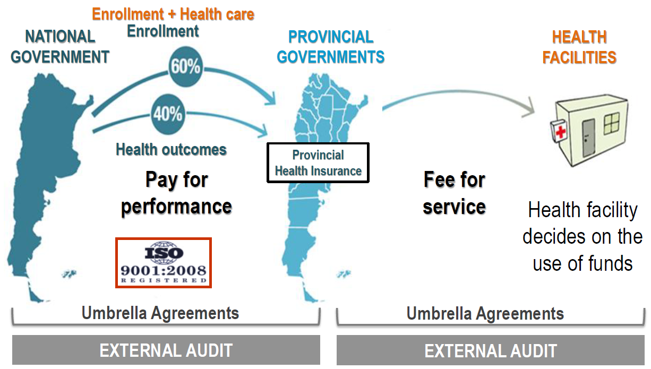
Argentina’s Plan Nacer uses a results-based financing scheme based on enrollment and health outcomes

Slide 25
Punjab province in Pakistan reformed its allocation model to reflect local needs while rewarding districts for improvement in performance
Performance-Based Equitable Resource Allocation
Base Allocation (70%)
Performance Indicators (30%)
# of health facilities
Social deprivation index
Rural population
Maternal and child mortality index
% pregnant women receiving antenatal care
% women delivered by skilled birth attendants
Tetanus Toxoid II coverage in pregnant women
*
Notes:
Another example – INDIA: Incentive Grant from 13th Finance Commission (in Anit’s presentation)
Performance-based incentive to reduce IMR
Resources available: Rs.50 Bn (US$1 bn) from 2013-15
Performance measured against 2011 Sample Registration System (SRS) baseline
Formula consists of two parts:
Improvement in absolute value of the parameter
Premium if the value is above the median for all states

Slide 26
Data is slow, inconsistent and difficult to access
CHALLENGES
OPPORTUNITIES
Health policy is constrained by lack of consistent, timely and relevant data
Latest household survey conducted before the National Health Mission started, difficult to do any reliable exercise on impact
Administrative data is hard to access, no national level assessment of healthcare quality
Lessons from international good practices (Mexico, Thailand, NHS)
Setting collection and dissemination standards for admin data through independent agency– CGD’s work on priority setting and data compact
Leverage biometric registration (Aadhaar) to create a warehouse for Electronic Health Record

Slide 27
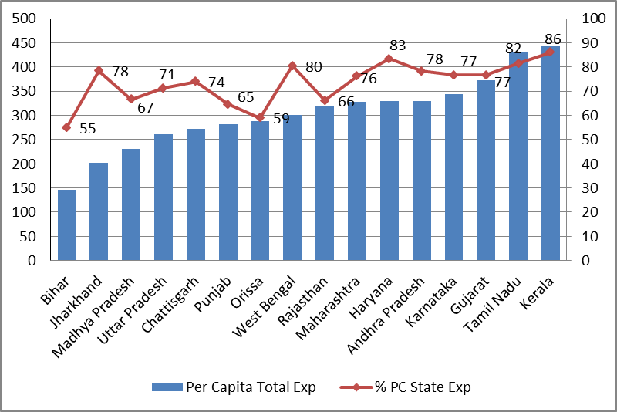
Poorer and High-Burden States Depend Relatively
on More Transfers
Key Questions
Can state per capita income alone explain the low level of expenditure, or are there state-specific factors that have not been adequately researched? What are the challenges for this research agenda?

Slide 28
Major beneficiaries of devolution will be poorer states
Increase in Fiscal Space and Per Capita Devolution post 14th FC Report
 | Share in Total Devolution (taxes & grants in aid) | Increase as % of projected GSDP
Chhattisgarh | 2.8% | 2.9%
Kerala | 3.1% | 1.8%
WB | 8.1% | 2.5%
MP | 6.9% | 2.6%
Jharkhand | 2.9% | 2.8%
Odisha | 4.3% | 1.9%
Karnataka | 4.3% | 1.1%
UP | 16.3% | 2.2%
Rajasthan | 5.2% | 1.1%
Bihar | 8.8% | 2.6%
Punjab | 1.5% | 0.7%
Maharashtra | 5.4% | 0.6%
Gujarat | 3.0% | 0.6%
Haryana | 1.1% | 0.4%
TN | 3.8% | 0.3%
Source: 14th Finance Commission (2015); AI-CGD calculations

Slide 29
Some states have less funds available this year compared to last
Change in Central Transfers to States (2014-15 RE vs. 2015-16 BE)
 | Change in Share of Central Taxes | Change in Central Grants-in-aid | Change in Total Central Transfers to States
Jammu and Kashmir | 3500.5 | -2261.0 | 1239.5
Himachal Pradesh | 1119.5 | 3397.5 | 4517.0
Haryana | 2024.5 | 158.4 | 2182.9
Uttarakhand | 1619.0 | -3646.0 | -2027.0
Rajasthan | 8507.8 | -3751.0 | 4756.8
Chhattisgarh | 7597.2 | -2134.6 | 5462.6
Bihar | 12665.6 | -10732.6 | 1932.9
Goa | 1053.6 | 122.3 | 1175.9
Karnataka | 9691.9 | -10559.4 | -867.4
Kerala | 4955.5 | 452.4 | 5408.0
Source: State Budgets; Finance Commission Reports

Slide 30
Implications: 14th FC Report on Fiscal Transfers for Health
The 14th FC devolution increases States’ fiscal space
Greater transfers to the States also mean that fiscal space of the Center has reduced significantly
Increased fiscal space, higher per capita fiscal devolution, and restructuring of the National Health Mission creates a policy environment for health that is both an opportunity and a challenge

Slide 31
Proposed Recommendations
Increase public spending on health: set a target of at least 5% of GDP for public expenditure on health by 2020 (from 1.2% currently)
Move money to the States: combine block grants with incentives for performance based on health outcomes
Funds should follow services: design a prioritized, cost-effective, and fiscally sustainable benefits package of healthcare services
Improve accountability and data: independent institution(s) should collect, manage and analyze health-related information, and measure state-level outcomes

Slide 32
Not all equalization grants for health are actually released
Equalization Grants for Health Released to States, 2005-10
State |  | % Released
 |  | 100%
 |  | 90%
 |  | 80%
 |  | 79%
 |  | 79%
 |  | 77%
 |  | 67%
Source: Planning Commission, 2012; 1 crore=10 million

Slide 33
The impact of EGH on eliminating the horizontal imbalance among states was fairly limited

